Slide 1
Life AI Service
Understand languages Quickly

Slide 2
Problems people face
Most people didn't find a good way to learn a new language although there are many websites and courses on the internet that introduce many services that help to learn.
If we provided a new way using our senses (Hearing and speaking) in addition to Writing and reading, it will take the people from zero level to fluency level
Our educational system will be attractive to most people because it will be a communication tool between the Client and the system like google assistant service.

Slide 3
Our Solution
Software solution will provide an interactional and emotional link between the people that need to learn and our system like a student and his teacher.
When people communicate with our system for the first time they will be tested against our AI tester to find out the level that they will get a start, then they will take a good travel to up levels of fluency.
Every Level will include four main sections
Hearing
Speaking
Writing
Reading
Every Level will have its own difficulty and also there will be in each section many of activities that will enhance the clients fluency.
Levels will begin from zero to undefined level, meaning that it will focus on all aspects of each languages.

Slide 4
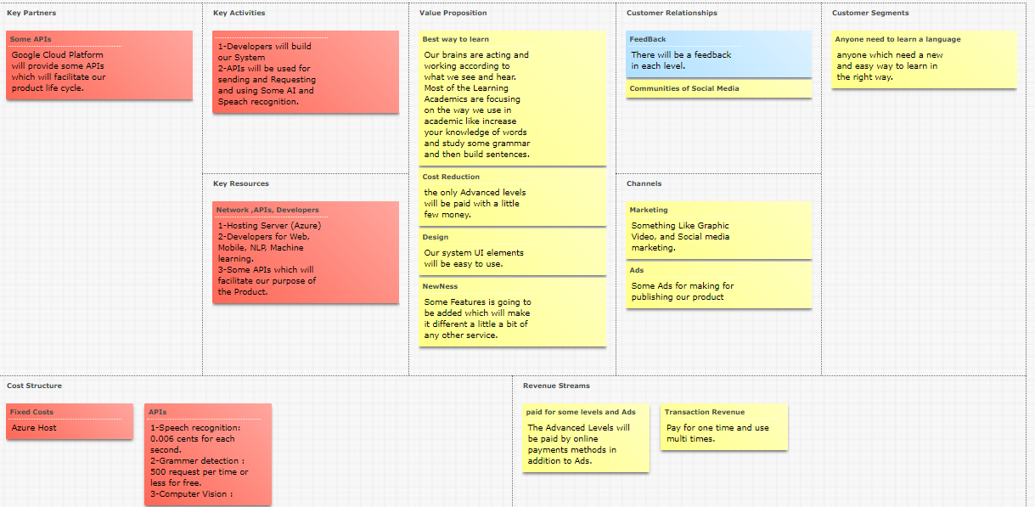

Slide 5
Technical Plan
Platform and Technology
Computer Sciences
Technologies for creating a web site will be
.NET Framework
Asp. Net MVC
REST APIs and GraphQL and other APIs
Sql Database
Client Side development
NLP for matching between each text being entered and the data that be returned from the image using Computer Vision API.
Grammar Detection Algorithm and Semantic(NLP) .
Machine learning : if there are any synonymous for any word saved in my DB it will be saved in its category.
Speech recognition (API)
Mobile Application
Android development

Slide 6
Some Problems we will face
How to implement machine learning Algorithms for matching between Synonyms and save the new words to the DB in the category!
Learning how to use a NLP with Python for Grammar checker.
How to make a similarity testing between every image’s data and the input ,and also evaluating the client according to the input.(Using NLP)
How can I Improve the system to create a new meaningful sentences and relate it to its Photos and Videos.
Design of Database
Semantic Designing

Slide 7
Team Requirements
Good designer and Client side developers for chatting system like (Google Assistant)
Good experience in Knowledge base with ability to increase information capacity.
Good Knowledge of each language will be inserted as a service and the best practices of training the clients with clear activities to achieve the specific goals.
Good experience in Backend (server side) and front end(client side)
Good knowledge in AGILE SCRUM

Slide 8
Project Requirements
Chat Design like (Google Assistant)
List all the activities needed in each Practice
Relation between the needed activities and Data Base
Algorithms for Improving the system and increasing the knowledge base
Speech Recognition subsystem (API)
Grammar detection Algorithms (NLP)
Computer Vision API for collecting some information about any image in the Data Base or will be inserted
Comparing between the Image details and the sentence(s) from the client and Correction algorithm for Evaluating.

Slide 9
Activities
Hearing Activities
Audio with several texts and one of them are correct.
Audio and then the sentence with missing words.
Audio and try to find the mistake in the text.
Audio and then JIGSAW puzzle.
Audio with a word and then check if it is said or not.
Audio and then enter the sentence that you understand.
//Several audios with a common word to get it out.
Insert an audio you need to understand and the sentence you think and we will out the sentence with corrections.
Audio and two similar wards and then what did you hear?

Slide 10
Activities
Speaking Activities
Listen to the right voices in letters , words, sentences
Choose the right word
Simi words with different voices
Speak after listening.
choose the right voice for the words or sentences.
Insert an Image and speak about it and system will evaluate.
Conversation modules

Slide 11
Activities
Reading Activities
Some words from the sentence with its graphic shape.
choose the words according to the Image and audio.
Make a small paragraph with images and audios.
Choose the missing word.
Rearrange the randomly sentences according to the story cycle.
Combine the sentence from the Sections.

Slide 12
